Slide 1
Welcome to all
for the Advertising Online lecture
By
Dr. Dhiraj Ovhal
HOD of Commerce

Slide 2
Q.2 Active parties involved in Advertising Process ?
Meaning:-
Active parties in advertising process means those who are directly and indirectly involved in advertising process such as
Audience
Advertiser
Media
Ad agency
Production Houses/Firms
Government Authority
Marketing Research firms

Slide 3
Q.2 Active parties involved in Advertising Process ?
I am watching Tata Nano Ad on T.V. )

Slide 4
(Way to remember :-
Example . I am watching Tata Nano Ad on T.V. )
( I - means Audience.
Tata Nano-means Advertiser,
T.V.-means Media)
( Tata has so many products so he will not able to prepare his all ad campaign therefore he would take support from Ad Agency.
And in ad agency the real work will done by Production Houses/Firms .
All Ads work is controlled and guided by Government authority )

Slide 5
Audience :-
It means target customers for the ad campaign
It includes Viewers, Listeners, Readers-
Audience - Prospect into regular customer
. Viewers:- The Audiences are watching T.V
Listeners:- The Audiences are listing Radio
Readers:- The Audiences are reading Newspaper, Magazines, etc.

Slide 6
2. Advertiser :-
Owner or Seller of products
It Includes Manufactures, Seller, Retailers, Wholesalers, Government organisation, Education trust, Hospitals, etc,

Slide 7
3.Media :-
It means channel of communication through which ad messages are transmitted or transferred to the target audience .
There are various media options are available in the market such as
Press, Broadcasting, outdoor ,other media.

Slide 8
Ad agency:-
Meaning:-
The ad agency plan, prepare and place of advertising campaign in media on behalf of the advertiser.
Definition :-
The Association of Advertising Agency of American)
( AAAA)
“An independent business organization, composed of creative and business people who develop, prepare and place advertising

Slide 9
5. Production Houses/Firms:-
It involves creative people like Copywriters, Visualizes, Art directors who convert raw ideas of advertising into final ad camping .
Various production firms available in the market such as
Balaji Films, SRK Production

Slide 10
6. Government Authority :-
Imposed rules and regulation for the smooth functioning of Ad Campaign.
To control advertising process and make to bound every advertiser to follow ethical code of conduct for advertising.

Slide 11
7. Marketing Research firms:-
It is an independent research organization or firms to collect market data.
It is also part of the advertiser firm to collect relevant marketing data for the ad campaign

Slide 12
(Way to remember :-
Example . I am watching Tata Nano Ad on T.V. )
( I - means Audience.
Tata Nano-means Advertiser,
T.V.-means Media)
( Tata has so many products so he will not able to prepare his all ad campaign therefore he would take support from Ad Agency.
And in ad agency the real work will done by Production Houses/Firms .
All work is controlled and guided by Government authority )

Slide 13
Feedback Link :-
https://forms.gle/U4Da9ykpniL3tpCdA

Slide 14
Thank You

Slide 15
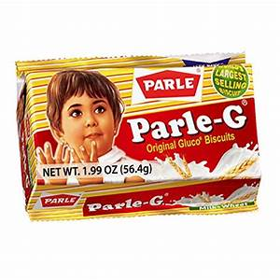
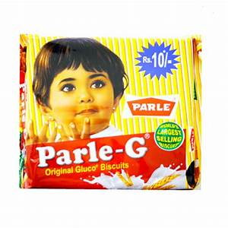
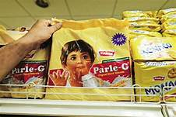

Slide 20
1. What are the Advertising Campaign of Parle G Over the period????
1. What are the Products having by Parle G????

Slide 21
Parle-G, 20-20, Magix, Milkshakti, Melody, Mango Bite, Poppins, Londonderry, Kismi Toffee Bar, Monaco and KrackJack).
Frooti and Appy.
Parle Bisleri .

